Slide 1

Data Clustering
By: Sayed A. Omar

Slide 2

Introduction to data clustering
Data Clustering
Data clustering is a problem of unsupervised learning tends to sperate data into sub groups depends on some techniques without mention the subgroup name, only it divides them.
Is it useful?
It is very useful for data with unknown categorize or classes to keep the similar observations together then we can label them later.

Slide 3
Business Uses
Behavioral segmentation:
Segment by purchase history
Segment by activities on application, website, or platform
Define personas based on interests
Create profiles based on activity monitoring
Inventory categorization:
Group inventory by sales activity
Group inventory by manufacturing metrics

Slide 4
Business Uses
Sorting sensor measurements:
Detect activity types in motion sensors
Group images
Separate audio
Identify groups in health monitoring
Detecting bots or anomalies:
Separate valid activity groups from bots
Group valid activity to clean up outlier detection

Slide 5
Algorithm
The Κ-means clustering algorithm uses iterative refinement to produce a final result. The algorithm inputs are the number of clusters Κ and the data set. The data set is a collection of features for each data point. The algorithms starts with initial estimates for the Κ centroids, which can either be randomly generated or randomly selected from the data set. The algorithm then iterates between two steps:
1. Data assignment step:
Each centroid defines one of the clusters. In this step, each data point is assigned to its nearest centroid, based on the squared Euclidean distance. More formally, if ci is the collection of centroids in set C, then each data point x is assigned to a cluster based on
where dist( · ) is the standard (L2) Euclidean distance. Let the set of data point assignments for each ith cluster centroid be Si.

Slide 6
Algorithm
2. Centroid update step:
In this step, the centroids are recomputed. This is done by taking the mean of all data points assigned to that centroid's cluster.
The algorithm iterates between steps one and two until a stopping criteria is met (i.e., no data points change clusters, the sum of the distances is minimized, or some maximum number of iterations is reached).
This algorithm is guaranteed to converge to a result. The result may be a local optimum (i.e. not necessarily the best possible outcome), meaning that assessing more than one run of the algorithm with randomized starting centroids may give a better outcome.

Slide 7
Input & Output
Input
K : Clusters number
Data : dataset to be clustered
Output
The centroids of the K clusters, which can be used to label new data
Labels for the training data (each data point is assigned to a single cluster)

Slide 8
Choosing K
The algorithm described previously finds the clusters and data set labels for a particular pre-chosen K. To find the number of clusters in the data, the user needs to run the K-means clustering algorithm for a range of K values and compare the results. In general, there is no method for determining exact value of K, but an accurate estimate can be obtained using the following techniques.

Slide 9
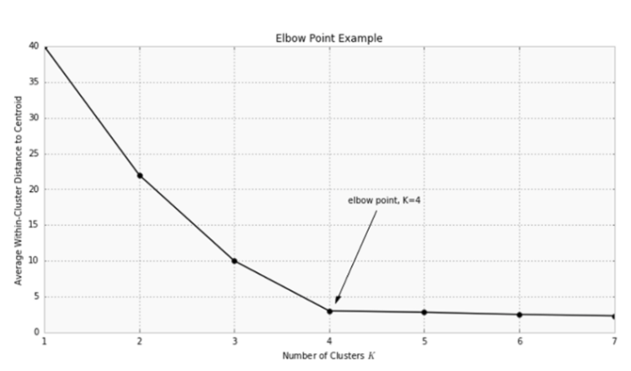
Choosing K
ONE OF THE METRICS THAT IS COMMONLY USED TO COMPARE RESULTS ACROSS DIFFERENT VALUES OF K IS THE MEAN DISTANCE BETWEEN DATA POINTS AND THEIR CLUSTER CENTROID. SINCE INCREASING THE NUMBER OF CLUSTERS WILL ALWAYS REDUCE THE DISTANCE TO DATA POINTS, INCREASING K WILL ALWAYS DECREASE THIS METRIC, TO THE EXTREME OF REACHING ZERO WHEN K IS THE SAME AS THE NUMBER OF DATA POINTS. THUS, THIS METRIC CANNOT BE USED AS THE SOLE TARGET. INSTEAD, MEAN DISTANCE TO THE CENTROID AS A FUNCTION OF K IS PLOTTED AND THE "ELBOW POINT," WHERE THE RATE OF DECREASE SHARPLY SHIFTS, CAN BE USED TO ROUGHLY DETERMINE K.

Slide 10
Implementation
Clean and Transform Your Data
Feature Engineering
Choose K and Run the Algorithm
Review the Results
Iterate Over Several Values of K

Slide 11
Problems of K-means
Linear separability : You rarely have to deal with circular clusters in real life data. It's even better to assume they do not exist in these cases. Allowing your algorithm to search for them would allow it to find odd circular clusters in the noise. The linear assumption in K-means makes it often more robust.
Number of clusters : There is often no true ideal number of clusters that you wish to see. For text classification for example, there may be 100 categories, 105, 110... it's all rather subjective. Specifying the number of clusters becomes equivalent to specifying a global granularity. All clustering methods need a granularity specification anyway.
Global maximum : I think it's a true issue. The true abstract K-means that would consist in finding the global minimum for the S.O.D is fundamentally NP-Hard. Only Lloyd is affordable and it is... very imperfect. We have really seen that being close to the real minimum (thanks to replications) clearly improved the quality of the results. Replication of the K-means is an improvement but not a perfect solution. For a big dataset you would need 10a lot10a lot replications to have a small chance to find the true minimum. Others methods like "finish it with greedy search" (proposed in MATLAB) are astronomically costly in big datasets.
Outliers : each point must be clustered to only one group

Slide 12
Density-based Clustering : DBSCAN
Density-based spatial clustering of applications with noise (DBSCAN) is a data clustering algorithm proposed in 1996. It is a density-based clustering algorithm given a set of points in some space, it groups together points that are closely packed together (points with many nearby neighbors), marking as outliers points that lie alone in low-density regions (whose nearest neighbors are too far away).
DBSCAN is one of the most common clustering algorithms and also most cited in scientific literature.
In 2014, the algorithm was awarded the test of time award (an award given to algorithms which have received substantial attention in theory and practice) at the leading data mining conference, KDD.

Slide 13

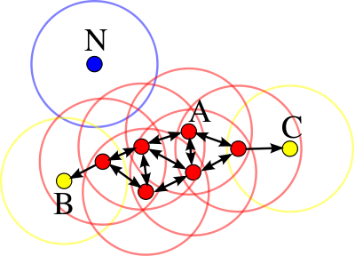
Technique
Consider a set of points in some space to be clustered. For the purpose of DBSCAN clustering, the points are classified as core points, (density-)reachable points and outliers, as follows:
A point p is a core point if at least minPts points are within distance ε (ε is the maximum radius of the neighborhood from p) of it (including p). Those points are said to be directly reachable from p.
A point q is directly reachable from p if point q is within distance ε from point p and p must be a core point.
A point q is reachable from p if there is a path p₁, ..., p_{n} with p₁ = p and p_{n} = q, where each p_{i+1} is directly reachable from p_{i} (all the points on the path must be core points, with the possible exception of q).
All points not reachable from any other point are outliers.
Now if p is a core point, then it forms a cluster together with all points (core or non-core) that are reachable from it. Each cluster contains at least one core point; non-core points can be part of a cluster, but they form its "edge", since they cannot be used to reach more points.

Slide 14

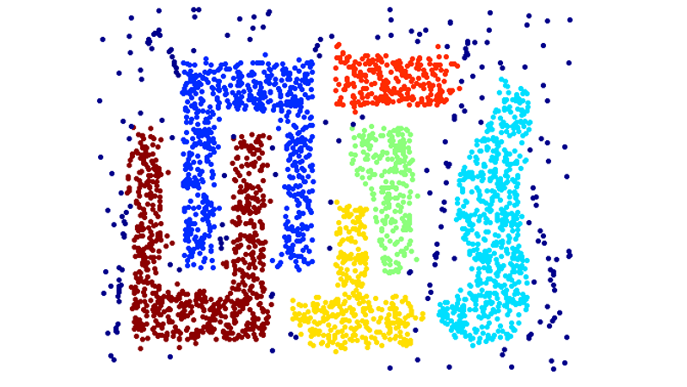

Slide 15
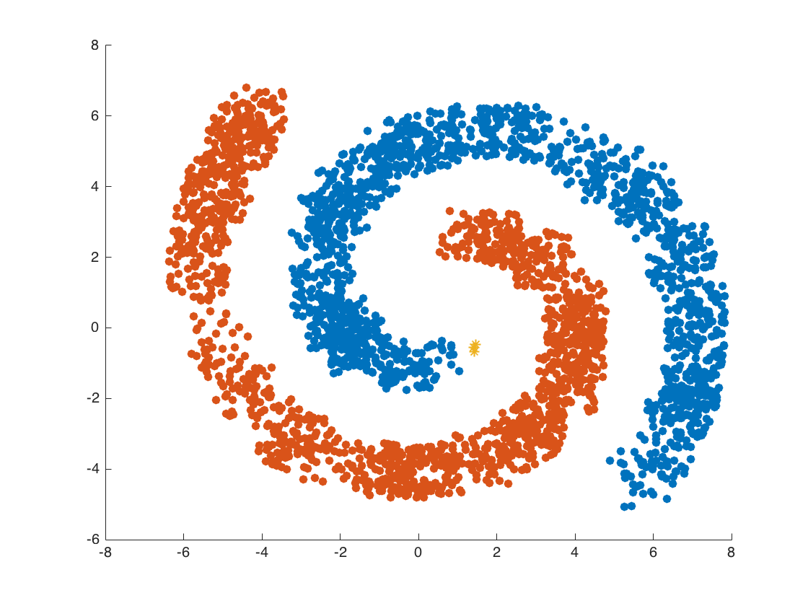

Slide 16
Dbscan Advantages
Doesn’t require K to be defined
Can discover arbitrarily shaped clusters
Find cluster completely surrounded by different clusters
Robust towards outliers detection (noise)
Require just two parameters (can be set by a domain expert)

Slide 17
Dbscan disadvantages
Datasets with altering densities are tricky
Sensitive to clustering parameters (minPts , eps)
Fails to identify cluster if density varies and if the dataset is too sparse
Sampling affects density measures
Not partition able for multiprocessor systems

Slide 18
References
https://www.datascience.com/blog/k-means-clustering
https://en.wikipedia.org/wiki/DBSCAN
https://www.researchgate.net/figure/Advantages-Disadvantages-and-Applications-of-DBSCAN_tbl2_271520302

Slide 19



Thank you
Sayed A. Omar
01154447771
Sayed931
sayedomar

